Slide 1

Optimize Azure Synapse SQL Pools
{ |  | }
 | Azure Synapse SQL Pools

Slide 2

Table Partitioning
Module 10

Slide 3
Learning Units covered in this Module
Lesson 1: Table Partitions
Lesson 2: Partition Management
Lesson 3: Data Loading

Slide 4
Lesson 1: Table Partitions

Slide 5

Objectives
After completing this lesson, you will be able to:
Understand the following topics:
The concepts of Partitioning in Synapse SQL Pools

Slide 6
What are table partitions?
Table partitions divide data into smaller subset of data.
Partitioning is supported on all Synapse SQL pool table types.
Partitioning is supported for all distribution types.
Partitioning benefits loading and query performance.
Notes:
Table partitions enable you to divide your data into smaller groups of data. In most cases, table partitions are created on a date column. Partitioning is supported on all Synapse SQL pool table types; including clustered columnstore, clustered index, and heap. Partitioning is also supported on all distribution types, including both hash or round robin distributed.
Partitioning can benefit data maintenance and query performance. Whether it benefits both or just one is dependent on how data is loaded and whether the same column can be used for both purposes, since partitioning can only be done on one column.
More information: https://docs.microsoft.com/en-us/azure/synapse-analytics/sql-data-warehouse/sql-data-warehouse-tables-partition

Slide 7
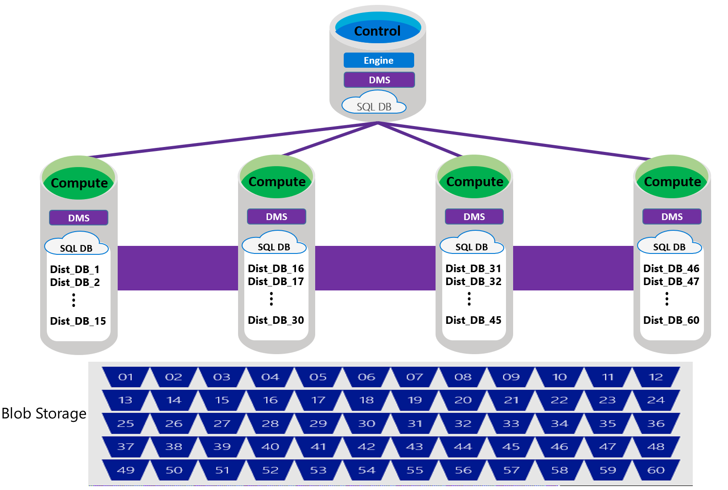
Synapse SQL Pool Storage Reminder
60 Fixed Distributions
Scale independently of compute
Each distribution is contained in an Azure SQL database
Notes:
Data is distributed into 60 distributions on storage
Each compute node is associated with a set of distributions
1 Node would have all 60 distributions
60 nodes would have 1 distribution each
In this slide, explain the Database structure and the impact of partitioning.
Remind the audience the distributions structure

Slide 8
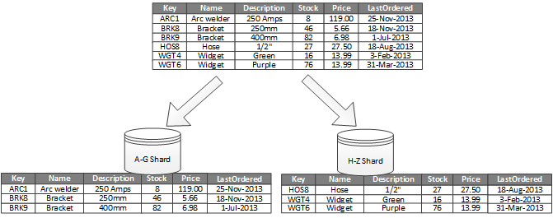
Distributions vs Partitions
Partitioning is separate to Distributing
Partitioning subdivides tables into smaller blocks
Based on a Key
Benefits for Query performance
Benefits for Loading performance
Distributed tables can be Partitioned
CCI tables can be Partitioned
Behind the scenes, partitioning is implemented as a separate ‘table’ per partition
Notes:
Partitioning is completely divorced from this concept of distribution. When we partition a table, we decide which rows belong into which partitions based on some scheme (like partitioning an order table by the order.create_date for instance). A chunk of records for each create_date then gets stored in its own table separate from any other create_date set of records (invisibly behind the scenes).
Partitioning is nice because you may find that you only want to select 10 days worth of orders from your table, so you only need to read against 10 smaller tables, instead of having to scan across years of order data to find the 10 days you are after.
Here's an example from the Microsoft website where horizontal partitioning is done on the name column with two "shards" based on the names alphabetical order:
Table distribution is a concept that is only available on MPP type RDBMSs like Azure DW or Teradata. It's easiest to think of it as a hardware concept that is somewhat divorced (to a degree) from the data. Azure gives you a lot of control here where other MPP databases base distribution on primary keys. Partitioning is available on nearly every RDBMS (MPP or not) and it's easiest to think of it as a storage/software concept that is defined by and dependent on the data in the table.
In the end, they do both work to solve the same problem. But... nearly every RDBMS concept (indexing, disk storage, optimization, partition, distribution, etc) are there to solve the same problem. Namely: "How do I get the exact data I need out as quickly as possible?" When you combine these concepts together to match your data retrieval needs you make your SQL requests CRAZY fast even against monstrously huge data.

Slide 9
Understanding Partitioning
Partitioning can be applied to
Replicated Tables
Distributed Tables
Heaps
Clustered Index
Columnstores
Notes:
Build the conversation on which type of tables the partitioning can be applied. Make sure the audience understand the concept of those table geometry

Slide 10
Creating a Table - Syntax
CREATE TABLE [dbo].[FactInternetSales]
(
[ProductKey] int NOT NULL
, [OrderDateKey] int NOT NULL
, [CustomerKey] int NOT NULL
, [PromotionKey] int NOT NULL
, [SalesOrderNumber] nvarchar(20) NOT NULL
, [OrderQuantity] smallint NOT NULL
, [UnitPrice] money NOT NULL
, [SalesAmount] money NOT NULL
)
WITH
(CLUSTERED COLUMNSTORE INDEX
,DISTRIBUTION = HASH([OrderDateKey])
,PARTITION ([OrderDateKey] RANGE RIGHT FOR VALUES
(20000101,20010101,20020101,20030101,20040101,20050101)
)
);

Slide 11
Partition Operations
ALTER TABLE
MERGE
SPLIT
SWITCH

Slide 12
Notes on Partitioning
Generally
All physical tables use same range values
Range can be right or left
Columnstore Index rowgroups
Partition size affects compression efficiency
Partition size can impact query performance

Slide 13
Sizing
The right number of partitions need to be chosen
Partitioning can be used to improve performance by reducing the amount of data to parse or process.
Creating a table with too many partitions can hurt performance due to processing overhead of Partitioning.
CCI tables
For best performance, the goal is >= 1M rows in each Partition.
Too many Partitions over a Distributed table can cause small, inefficient CCI rowgroups.
Notes:
While partitioning can be used to improve performance some scenarios, creating a table with too many partitions can hurt performance. These concerns are especially true for clustered columnstore tables. For partitioning to be helpful, it is important to understand when to use partitioning and the number of partitions to create. There is no hard fast rule as to how many partitions are too many, it depends on your data and how many partitions you loading simultaneously. A successful partitioning scheme usually has tens to hundreds of partitions, not thousands.
When creating partitions on clustered columnstore tables, it is important to consider how many rows belong to each partition. For optimal compression and performance of clustered columnstore tables, a minimum of 1 million rows per distribution and partition is needed. Before partitions are created, Synapse SQL pool already divides each table into 60 distributed databases. Any partitioning added to a table is in addition to the distributions created behind the scenes. Using this example, if the sales fact table contained 36 monthly partitions, and given that a Synapse SQL pool has 60 distributions, then the sales fact table should contain 60 million rows per month, or 2.1 billion rows when all months are populated. If a table contains fewer than the recommended minimum number of rows per partition, consider using fewer partitions in order to increase the number of rows per partition. For more information, see the Indexing article, which includes queries that can assess the quality of cluster columnstore indexes.

Slide 14
Limitations
Table must be created with at least 1 partition
Partitioning cannot be applied after creation
Boundary values must be represented as literals
Cannot use a variable
Cannot split / merge CCI Table partitions that contain data

Slide 15
Source Code Management
Define table with partitioning
Leave values empty
Use a while loop to split partitions
CREATE TABLE [dbo].[FactInternetSales]
(
[ProductKey] int NOT NULL
, [OrderDateKey] int NOT NULL
, [CustomerKey] int NOT NULL
, [PromotionKey] int NOT NULL
, [SalesOrderNumber] nvarchar(20) NOT NULL
, [OrderQuantity] smallint NOT NULL
, [UnitPrice] money NOT NULL
, [SalesAmount] money NOT NULL
)
WITH
(CLUSTERED COLUMNSTORE INDEX
,DISTRIBUTION = HASH([OrderDateKey])
,PARTITION ([OrderDateKey] RANGE RIGHT FOR VALUES ()
)
);
Notes:
This creates at least one partition that you can work with later.
e

Slide 16
Lesson 2: Partition Management

Slide 17
Identifying Partitions
CREATE VIEW [dbo].[vPartitionMetaData]
AS
SELECT t.name AS TableName
, i.name AS IndexName
, p.partition_number
, p.partition_id
, p.rows
, i.data_space_id
, f.function_id
, f.type_desc
, f.boundary_value_on_right
, r.boundary_id
, r.value AS BoundaryValue
FROM sys.tables AS t
JOIN sys.indexes AS I ON t.object_id = i.object_id
JOIN sys.partitions AS p ON i.object_id = p.object_id
AND i.index_id = p.index_id
JOIN sys.partition_schemes AS s ON i.data_space_id = s.data_space_id
JOIN sys.partition_functions AS f ON s.function_id = f.function_id
LEFT JOIN sys.partition_range_values AS r ON f.function_id = r.function_id
AND r.boundary_id = p.partition_number
WHERE i.index_id <= 1;

Slide 18
Parallel load to one table
Prerequisites
Table is partitioned
Load can be split by coarse partition boundary
Month
Region

Slide 19
Partition Switching Guidance
Match Table Definition
Data type
Null-ability
Partition boundary values
Not switched
Statistics!
Update statistics after the
Switch IN
Notes:
You have to switch the table in and then redo the stats.

Slide 20
Best Practices : Splitting Partitions
Keep first and last partitions empty
Eliminates data movement
Metadata operation
Use CTAS rather than Alter Table split
Alter Table could cause data movement
Alter Table is only partially parallel
CTAS to new table and partition switch
CTAS 8X faster than Alter Table

Slide 21
Splitting Partitions via DDL (Slow)
DistA
20191201
DistB
20191201
DistA
20200101
DistC
20191201
DistD
20191201
DistE
20191201
DistF
20191201
DistG
20191201
DistH
20191201
DistA
20200201
20200115
20200115
20200115
20200115
20200115
20200115
20200115
20200115
20200215
20200215
20200215
20200215
20200215
20200215
20200215
20200215
DistB
20200101
DistC
20200101
DistD
20200101
DistE
20200101
DistF
20200101
DistG
20200101
DistH
20200101
DistB
20200201
DistC
20200201
DistD
20200201
DistE
20200201
DistF
20200201
DistG
20200201
DistH
20200201
Notes:
Animation shows the pain of splitting populated partitions. Populated partitions move data to the new split partition parallel across the nodes, but serially down the distributions (in order to rollback in the event of a failure in any of the steps)

Slide 22
CTAS – Create Partition for Switch Out
CREATE TABLE dbo.FactInternetSales_out
WITH ( Distribution=HASH (SalesOrderNumber)
,CLUSTERED COLUMNSTORE INDEX
, PARTITION (OrderDateKey RANGE RIGHT FOR VALUES (20200401,20200501))
)
AS
SELECT *
FROM dbo.FactInternetSales tgt
WHERE 1=2
Notes:
The CTAS process must know how the partitions range to pull over the existing partition data:
- TargetPartitionValue and NextPartitionValue
- You can also partition based on a RANGE LEFT’scheme

Slide 23
CTAS – Create Partition for Switch In
CREATE TABLE dbo.FactInternetSales_in
WITH ( Distribution=HASH (SalesOrderNumber)
,CLUSTERED COLUMNSTORE INDEX
, PARTITION (OrderDateKey RANGE RIGHT FOR VALUES (20040101,20050101))
)
AS
SELECT *
FROM dbo.FactInternetSales tgt
WHERE tgt.OrderDateKey >= 20200401
AND tgt.OrderDateKey < 20200501
UNION ALL
SELECT *
FROM dbo.stg_FactInternetSales stg
Notes:
The CTAS process must know how the partitions range to pull over the existing partition data:
- TargetPartitionValue and NextPartitionValue
- You can also partition based on a RANGE LEFT’scheme

Slide 24
Splitting Partitions with CTAS (Fast)
Step 1 : CTAS
DistA
20191201 (Empty)
DistA
20200101
20200115
Step 2 : Switch Out
DistA
20191201
DistA
20191201
DistA
20200201
20200215
DistA
20200201
DistA
20200101
20200115
20200215
Step 3 : Alter Table Split
(metadata operation)
Step 4 : Switch In
(metadata operation)
Notes:
Animation shows the alternative to splitting the populated partition.
CTAS the populated partition into a new table with the desired partition boundaries
Partition Switch out the populated partition (the target of the split – which switches in an empty partition with the same boundary value)
Split the new empty partition in original table
Partition switch the populated partitions created in the CTAS in step 1 with the newly split and empty partitions in the original table

Slide 25
Lesson 3: Data Loading

Slide 26
Loading Data
Loading data into partitions with partition switching is a convenient way stage new data in a table.
To clear out the existing data in a partition, an ALTER TABLE used to be required to switch out the data. Then another ALTER TABLE was required to switch in the new data.
In Synapse SQL pool, the TRUNCATE_TARGET option is supported in the ALTER TABLE command.
With TRUNCATE_TARGET the ALTER TABLE command overwrites existing data in the partition with new data.
Notes:
Loading data into partitions with partition switching is a convenient way stage new data in a table that is not visible to users the switch in the new data. It can be challenging on busy systems to deal with the locking contention associated with partition switching. To clear out the existing data in a partition, an ALTER TABLE used to be required to switch out the data. Then another ALTER TABLE was required to switch in the new data.
In Synapse SQL pool, the TRUNCATE_TARGET option is supported in the ALTER TABLE command. With TRUNCATE_TARGET the ALTER TABLE command overwrites existing data in the partition with new data. Below is an example which uses CTAS to create a new table with the existing data, inserts new data, then switches all the data back into the target table, overwriting the existing data.
https://docs.microsoft.com/en-us/azure/synapse-analytics/sql-data-warehouse/sql-data-warehouse-tables-partition#:~:text=The%20primary%20benefit%20of%20partitioning%20in%20Synapse%20SQL,which%20the%20data%20is%20loaded%20into%20the%20database.

Slide 27
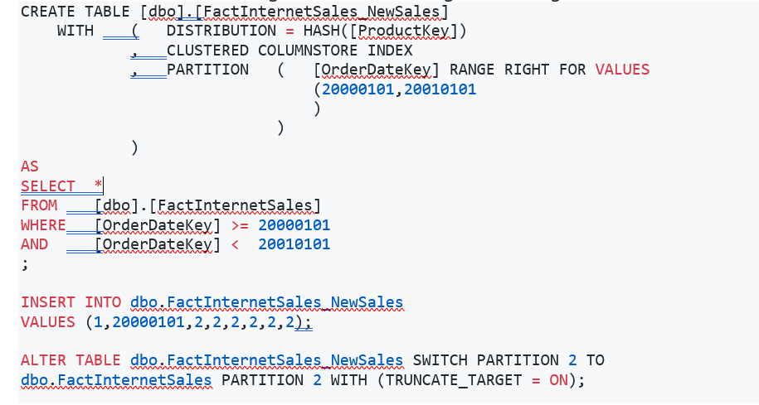
Loading Data
Notes:
Loading data into partitions with partition switching is a convenient way stage new data in a table that is not visible to users the switch in the new data. It can be challenging on busy systems to deal with the locking contention associated with partition switching. To clear out the existing data in a partition, an ALTER TABLE used to be required to switch out the data.
Then another ALTER TABLE was required to switch in the new data. In Synapse SQL pool, the TRUNCATE_TARGET option is supported in the ALTER TABLE command. With TRUNCATE_TARGET the ALTER TABLE command overwrites existing data in the partition with new data. Below is an example which uses CTAS to create a new table with the existing data, inserts new data, then switches all the data back into the target table, overwriting the existing data.

Slide 28
Parallel load to one Table
Solution
Create one table per partition boundary
Load data to each table in parallel
Switch partitions to the target table
ALTER TABLE claim_parallel_stage_1 SWITCH PARTITION 1 TO claim PARTITION 1 ALTER TABLE claim_parallel_stage_2 SWITCH PARTITION 2 TO claim PARTITION 2 ALTER TABLE claim_parallel_stage_3 SWITCH PARTITION 3 TO claim PARTITION 3 ...
Partition switch is a metadata-based operation!
Notes:
Partition switching
Synapse SQL pool supports partition splitting, merging, and switching. Each of these functions is executed using the ALTER TABLE statement.
To switch partitions between two tables, you must ensure that the partitions align on their respective boundaries and that the table definitions match. As check constraints are not available to enforce the range of values in a table, the source table must contain the same partition boundaries as the target table. If the partition boundaries are not then same, then the partition switch will fail as the partition metadata will not be synchronized.

Slide 29
Guidance: Partitioning
Don’t over partition
Partitioning granularity likely to differ to SQL Server
Data is already spread across 60 distributions
Columnstore index row groups up to 1,048,576 rows
Partition for data management
Sliding window development
Targeted index rebuilds
Notes:
For partitioning to be helpful, it is important to understand when to use partitioning and the number of partitions to create. There is no hard fast rule as to how many partitions are too many, it depends on your data and how many partitions you loading simultaneously. A successful partitioning scheme usually has tens to hundreds of partitions, not thousands.
When creating partitions on clustered columnstore tables, it is important to consider how many rows belong to each partition. For optimal compression and performance of clustered columnstore tables, a minimum of 1 million rows per distribution and partition is needed. Before partitions are created, Synapse SQL pool already divides each table into 60 distributed databases.
Any partitioning added to a table is in addition to the distributions created behind the scenes. Using this example, if the sales fact table contained 36 monthly partitions, and given that a Synapse SQL pool has 60 distributions, then the sales fact table should contain 60 million rows per month, or 2.1 billion rows when all months are populated. If a table contains fewer than the recommended minimum number of rows per partition, consider using fewer partitions in order to increase the number of rows per partition.
For more details please take a look at the below mentioned link:
https://docs.microsoft.com/en-us/azure/synapse-analytics/sql-data-warehouse/sql-data-warehouse-tables-partition#:~:text=The%20primary%20benefit%20of%20partitioning%20in%20Synapse%20SQL,which%20the%20data%20is%20loaded%20into%20the%20database.

Slide 30
Knowledge Check – Views
Do you need to create a Partition Function?
Can we implement Partitioning on a Heap table?
What are the possible Partition operations in an ALTER TABLE command?
Can we partition on the Distribution key?
Should we Partition on the Distribution Key?
Notes:
No, Synapse handle it automatically
Yes, all types of table in SQL Pool
ALTER TABLE, MERGE, SPLIT, SWITCH
Yes
No.
Bonus question: Why Not?
Because the data is already split into Distributions by the Hash Key.

Slide 31
Microsoft

